Slide 1
NEU LIFE - STUDENT FORUM
ANITA MOHANDAS
BHAVIK VORA
LIPSA PANDA
SAMEER SUMAN

Slide 2
OUR GOAL
Our goal is to improve the current Northeastern Website by adding an active student Forum website by December 2017.
This would help the incoming students, Faculty and Alumni by providing a public, approachable, multiple participant, searchable and filterable communication medium all at one place

Slide 3
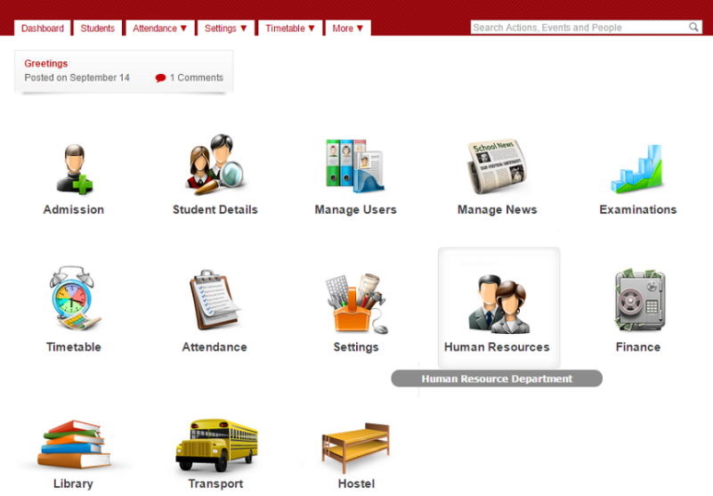

ISSUES
Students around the world around, be it undergraduate or graduate or post graduate seem to be lost after an admit due to either lack of information or available in disconnected silos.
Students find it difficult to access an interactive place where they can understand the coursework, the accommodation , Living in details leading to the need of a “Student Forum “.

Slide 4
OBJECTIVES
•Reliable and assured information by authentic users which are validated via their official university ID’s.
No need to look for information at multiple mediums and platforms.
•Managed content by moderators to avoid spam and trivial posts.
•Provides a medium to network, socialize and collaborate ideas.

Slide 5
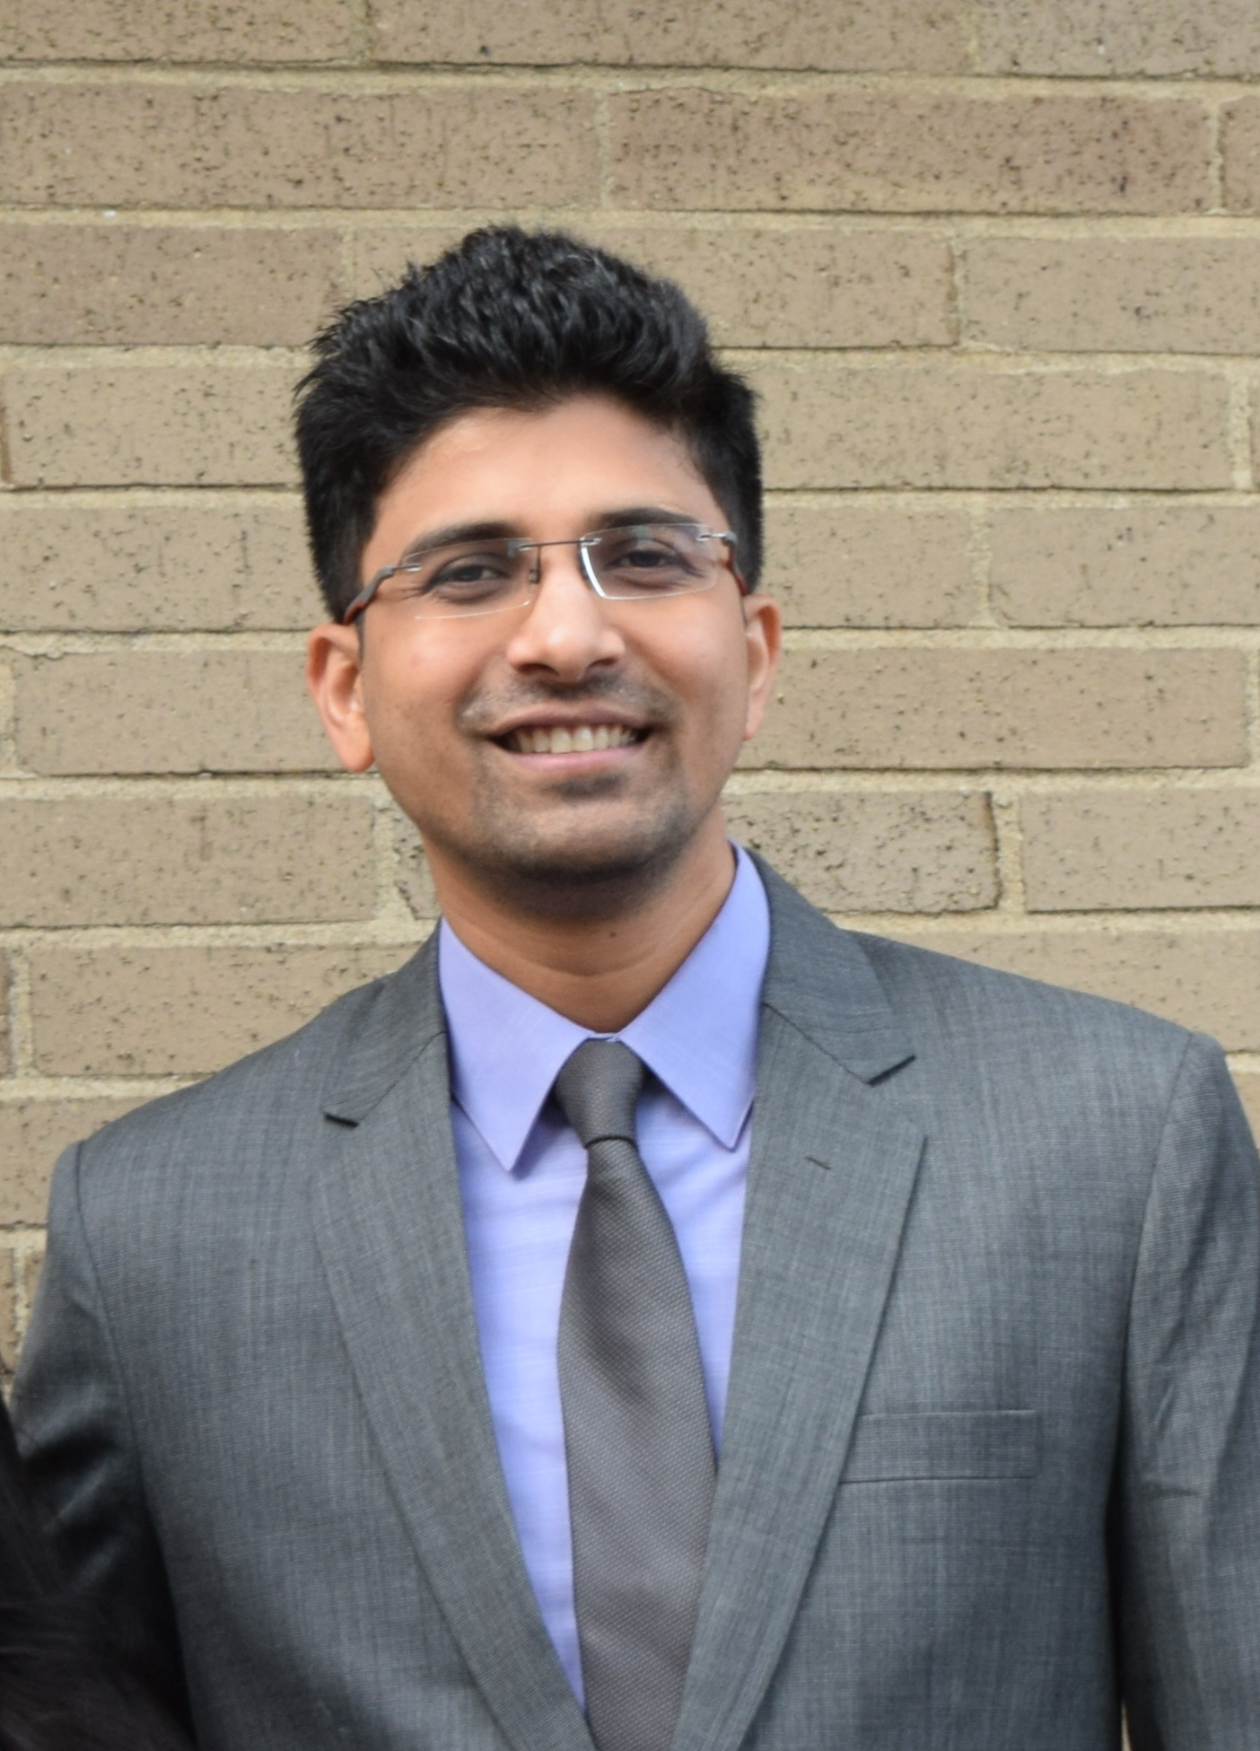
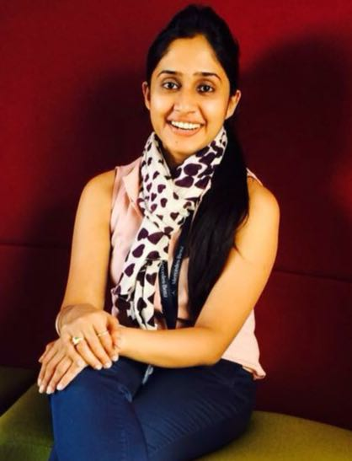
Business Case Analysis Team
Project Manager
-Analyzing and tracking the project and tasks and
creating business diagrams.
Business Analyst
-Creating Use Cases and Business requirements .

Slide 6
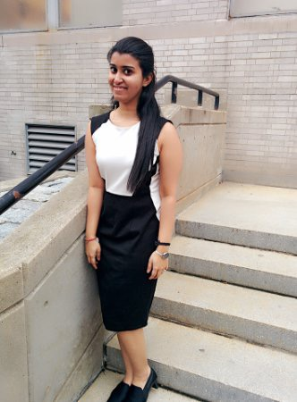
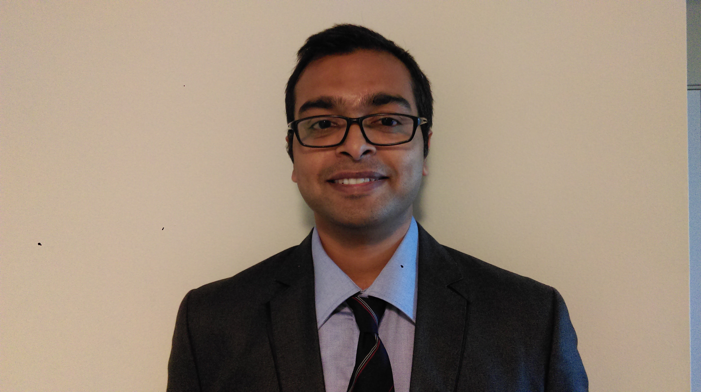
Business Case Analysis Team
UI/UX Designer
-Creating UI/UX for the project using Axure.
Developer/Tester
-Working on UI/UX and Checking use cases for efficient functionality

Slide 7
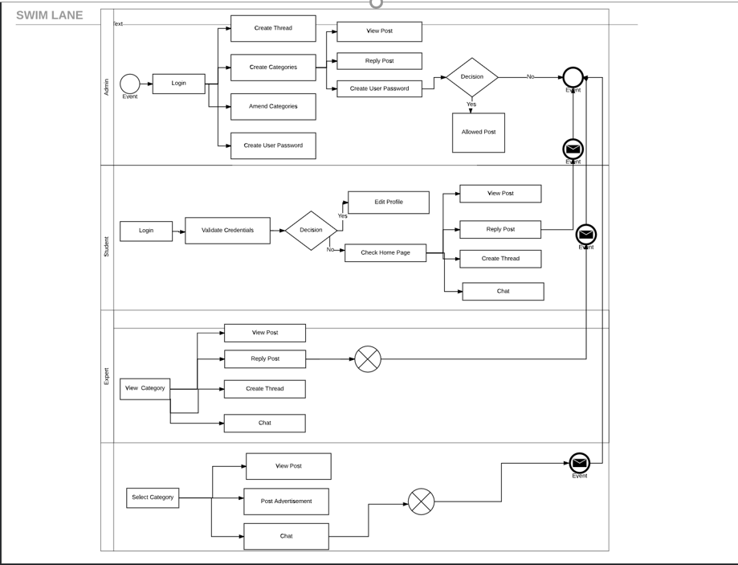

Slide 8
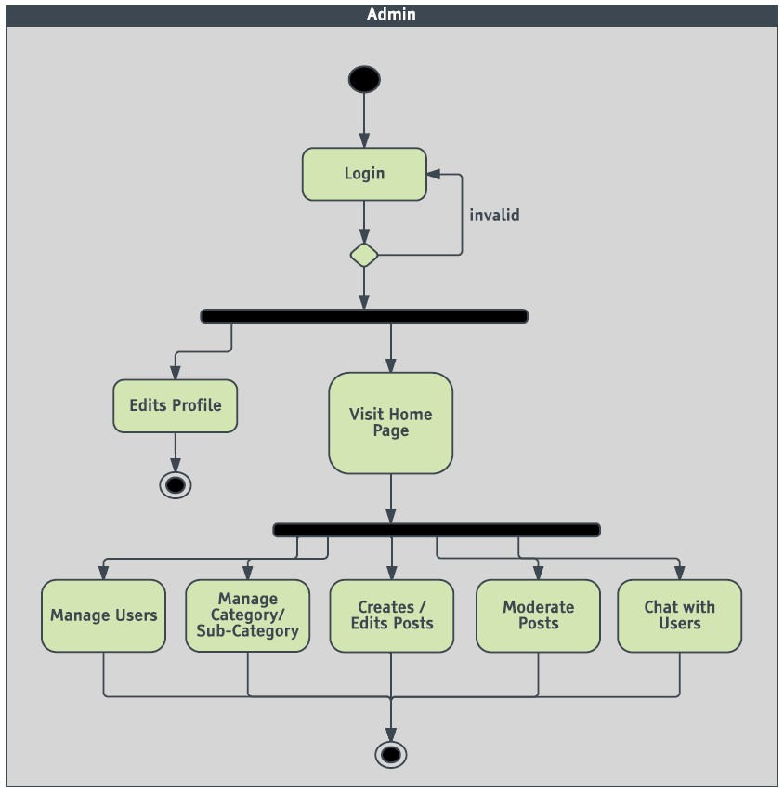
ACTIVITY DIAGRAM
Admin Activity

Slide 9
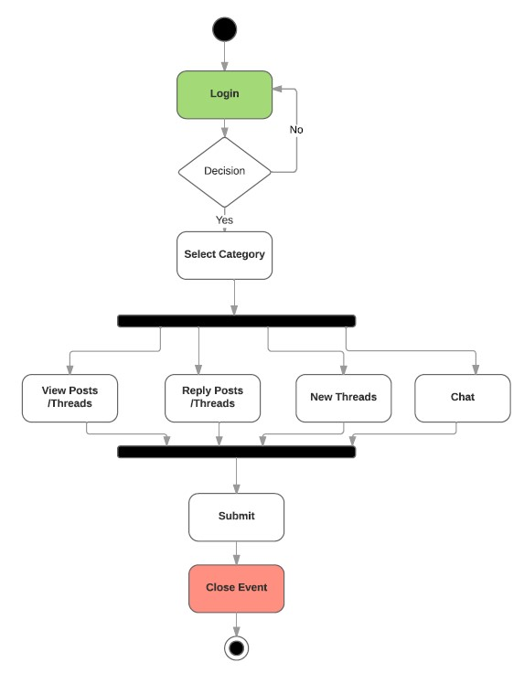
ACTIVITY DIAGRAM
Experts Activity

Slide 10
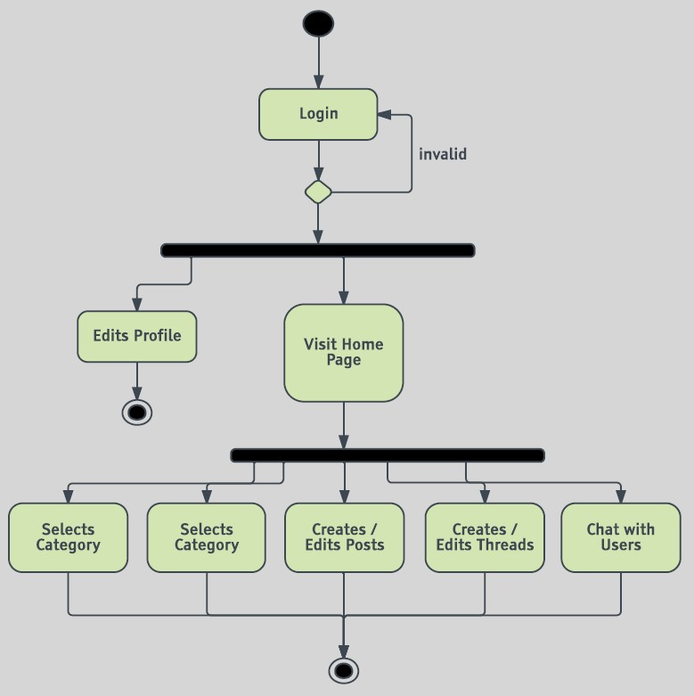
ACTIVITY DIAGRAM
Student Activity

Slide 11
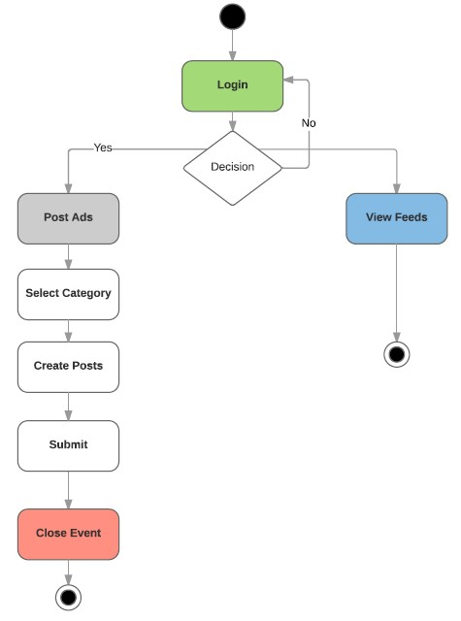
ACTIVITY DIAGRAM
Vendor Activity

Slide 12

NEU LIFE - STUDENT FORUM
SCOPE:
An interactive and informative portal to help incoming and existing students .
KEY STAKEHOLDERS :
-Administrators / Moderator
-Students
-Faculties
-Professors
-Vendors

Slide 13
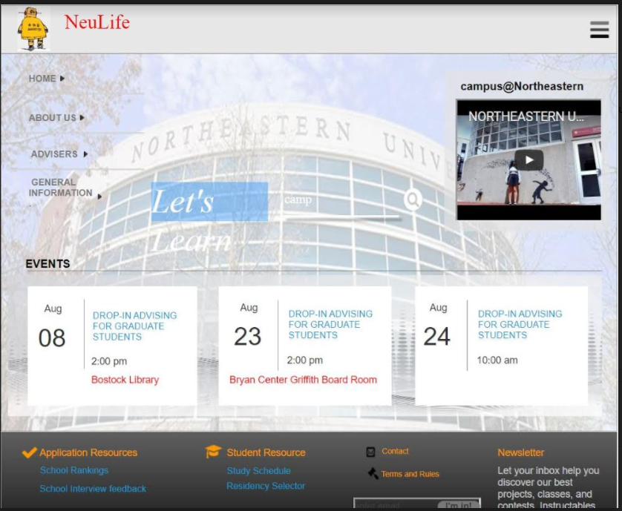
NEU LIFE- STUDENT LIFE

Slide 14
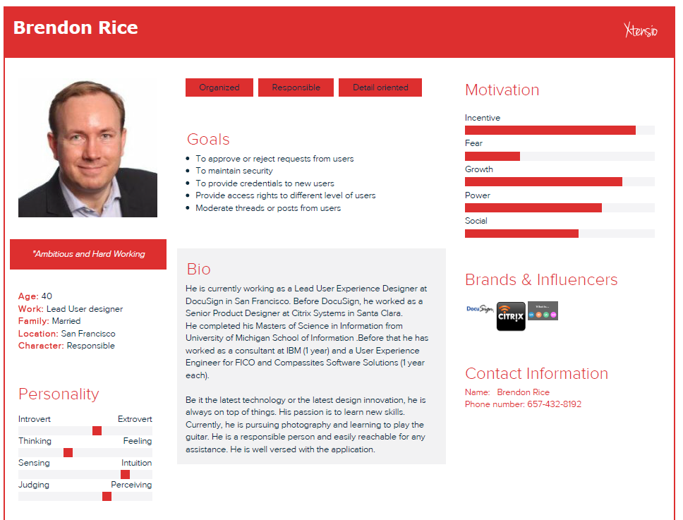
PERSONAS
Brendon Rice
Admin

Slide 15
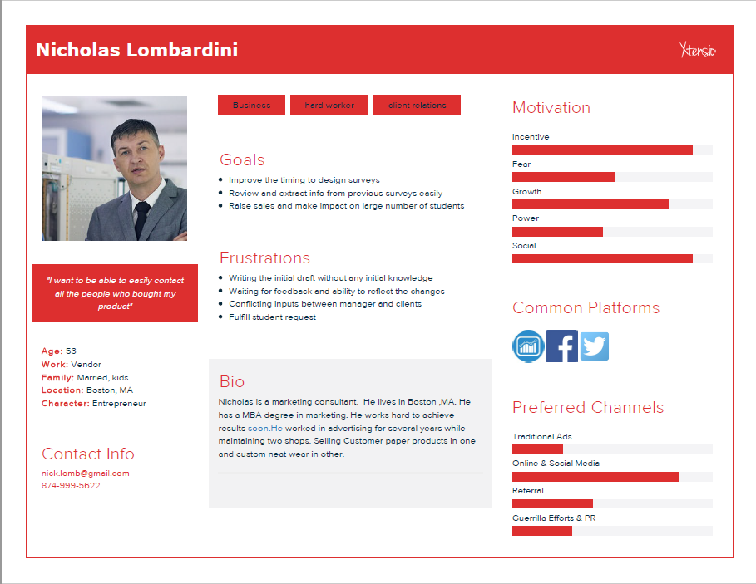
PERSONAS
Nicholas Lombardini
Vendor

Slide 16
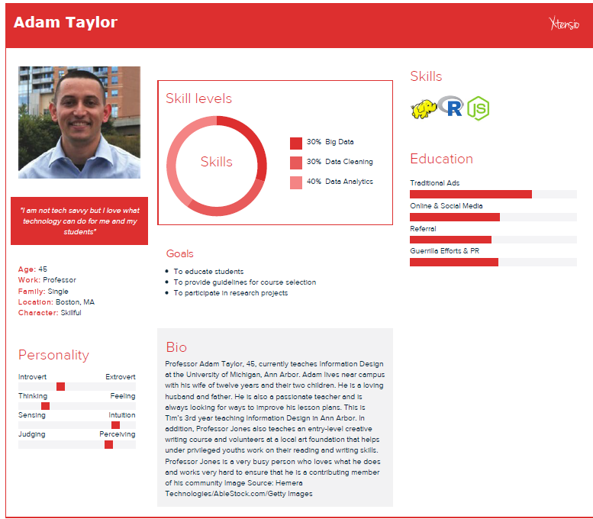
PERSONAS
Adam Taylor
Professor

Slide 17
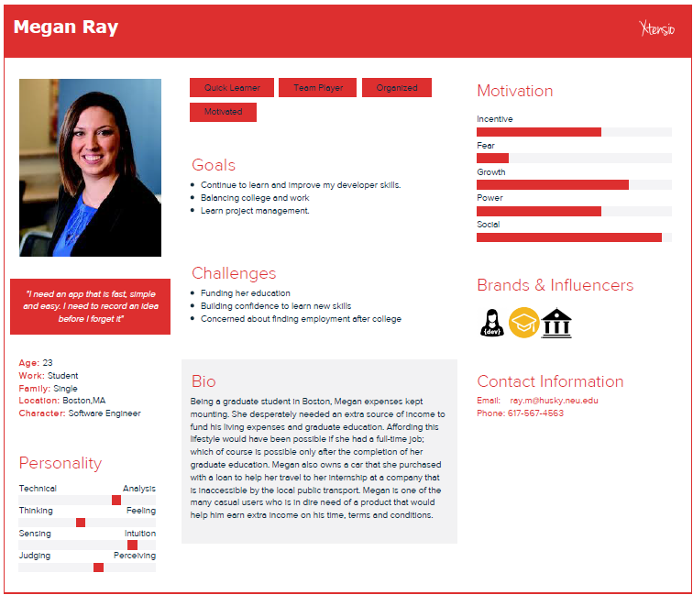
PERSONAS
Megan Ray
Student

Slide 18
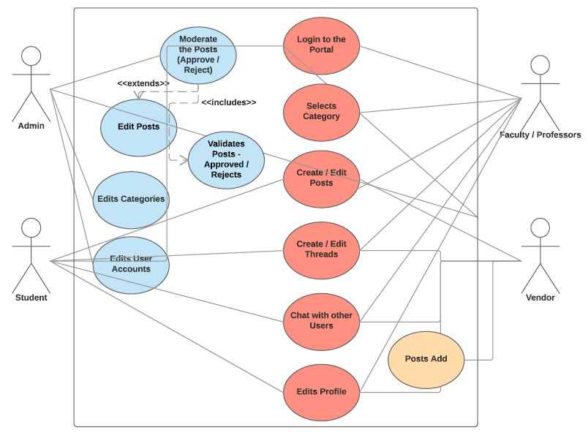
USE CASES
Admin
Experts
Students
Vendors

Slide 19
PRIMARY ACTORS AND USE CASES
Admin
-Create users, Edit users, Delete Users, Manage user request, view request, Delete one or multiple requests.
-Admin can create a new thread under a category.
-Admin can share information about a particular activity to the user.
-Admin selects one or more activities for which he needs to perform.
-Admin validates a post or a thread.

Slide 20
PRIMARY ACTORS AND USE CASES
Admin
-Admin selects one or more activities for which he needs to perform.
-Admin validates a post or a thread.

Slide 21
PRIMARY ACTORS AND USE CASES
Student
-Student selects "Check Home Page" from the menu.
-Student can view a particular post or a thread from any category from the dropdown .
-Student can chat with a professor or an alumni this could be with regards to a personal chat about his course work.

Slide 22
PRIMARY ACTORS AND USE CASES
Experts
-Experts Login and provide insights to students.
-Experts can give ratings
-Experts can View/ Reply/Create for any particular thread.
-Experts can also chat with the other members in the portal
via the chat option provided.

Slide 23
PRIMARY ACTORS AND USE CASES
Vendors
-Vendor can Post ads on all the upcoming activities .
-Vendor can View post related to his domain.
-Vendor can not edit posts.

Slide 24

LIVE DEMO

Slide 25
Reference Material
Reference Document Name
https://www.dropbox.com/home/BA_TeamWork?preview=Assignment6_TeamProject.pptx
https://www.dropbox.com/home/BA_TeamWork/Assignment7_Submission/classdiagram
https://www.dropbox.com/home/BA_TeamWork/Assignment7_Submission/ActivityDiagram

Slide 26

QUESTIONS
THANK YOU

